Slide 1
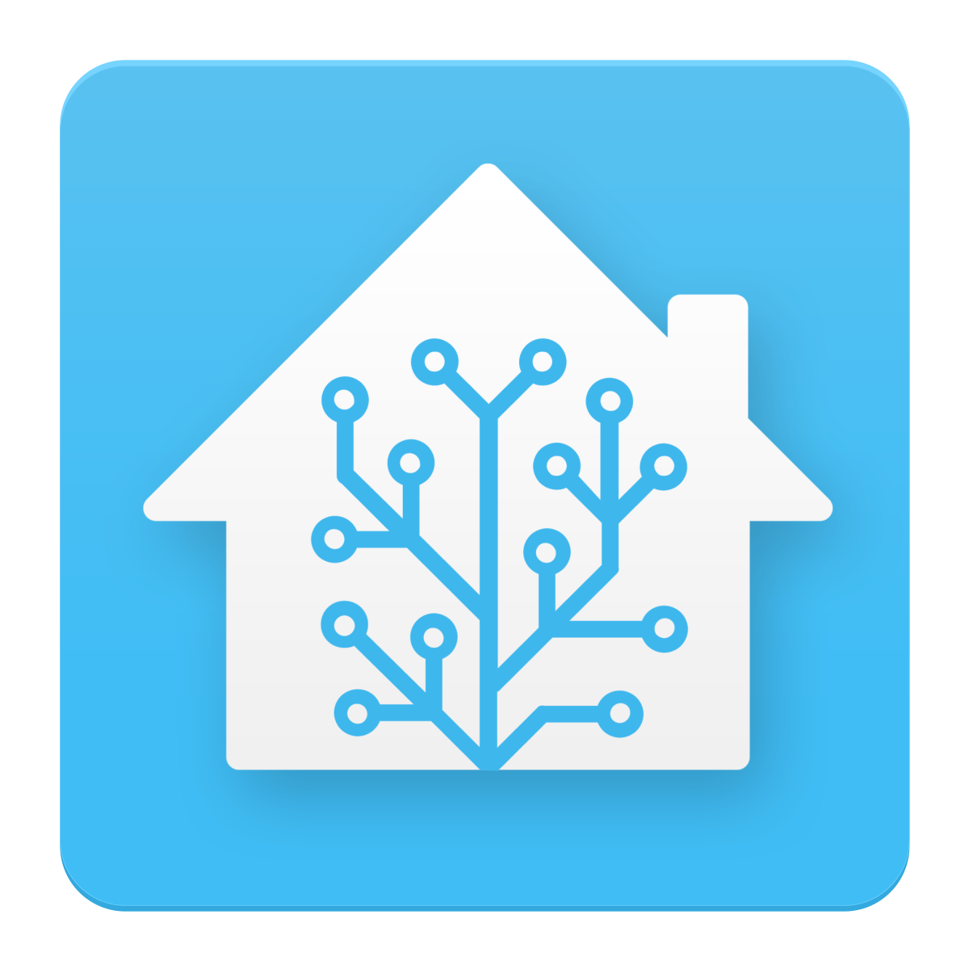
Home Assistant
Šimon Hořánek

Slide 2
What is it?

Slide 3

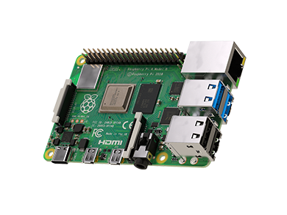
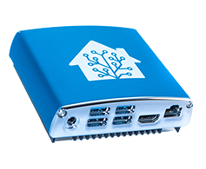
Open-Source
Home automatiztion hub
Support for 1000+ integrations
Installs on a small computer
You can:
Gather data
Control smart devices
Set up actions
Store all your data locally

Slide 4
Why Open-Source

Slide 5

Puts privacy first
No tracking
No data breaches
No random disconnections
Can be freely modified
Support for over 1000 devices
No memberships

Slide 6
Integrations

Slide 7
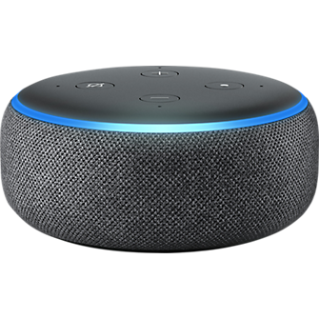
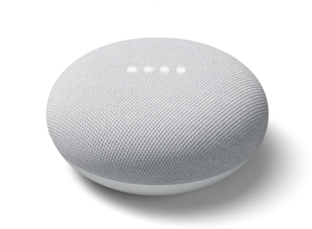

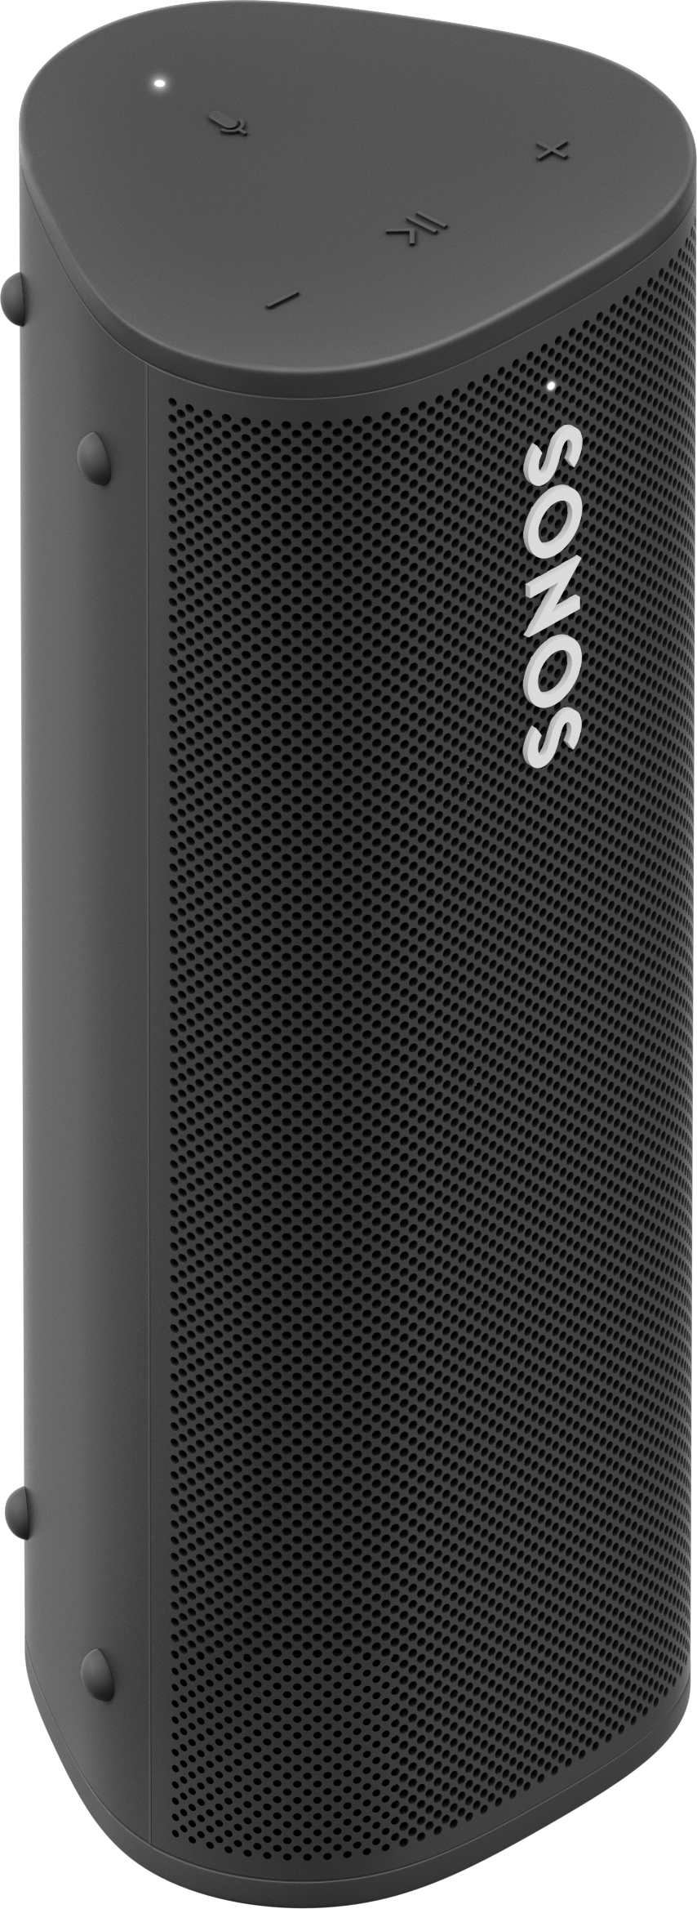
Amazon Alexa
Google assistant
IKEA TRÅDFRI
Philips Hue
MQTT
Zigbee
SONOS
HomeKit
And many more

Slide 8
Examples

Slide 9
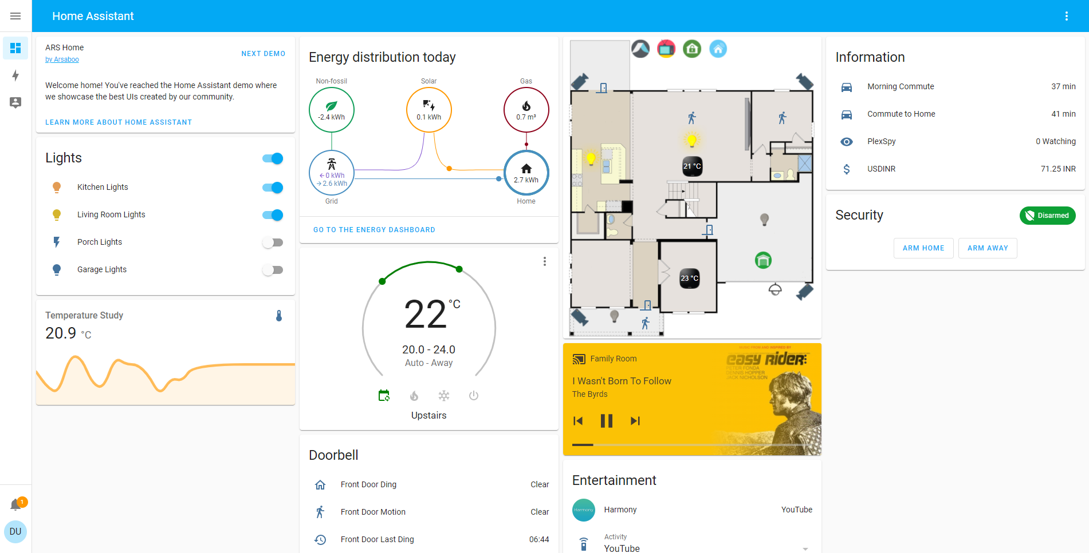

Slide 10
Learn More

Slide 11
Home Assistant (home-assistant.io)
Home Assistant Blue! - Home Assistant (home-assistant.io)
Integrations - Home Assistant (home-assistant.io)

Slide 12
Sources

Slide 13
Homey Pro vs. Home Assistant
https://www.verizon.com/products/amazon-echo-dot-3rd-gen/
Article Detail (sonos.com)
Inteligentní žárovky | Philips Hue (philips-hue.com)
Roam: A Portable Waterproof Smart Speaker | SonosNews | Open Source Initiative
Raspberry Pi | RS (rs-online.com)
Overview - Home Assistant (home-assistant.io)
Home Assistant (home-assistant.io)
Home Assistant Blue! - Home Assistant (home-assistant.io)

Slide 14
Thank you for your attention
This presentation is already available at: https://www.shimonh.eu

